Slide 1
NE 763: Advanced Reactor Materials
Fall 2026
Dr. Benjamin Beeler

Slide 2
Last Time
UN/PuN phases with high solubility; potential decomposition at low N2 pressures
Fabricate with excess N, N slightly increases with burnup
He/Na bonded pins; He has low fuel density, small gap; Na has high fuel density, large gap;
  roughly same total smear density, same as carbides
Three (temperature) regimes evolving with burnup: initial T ramp+cracking; densification+free swelling; contact with cladding and FCMI onset
Restructuring into 3 zones: porous center, grain growth, as-fab
FCMI is a key concern due to swelling and low creep in UN fuels
Nitriding of the cladding can occur, but has not been seen to dramatically degrade cladding
Carbothermic reduction for fabrication, can lead to O/C impurities, requires very high T for sintering
LFRs, will wrap up today and summarize…

Slide 3
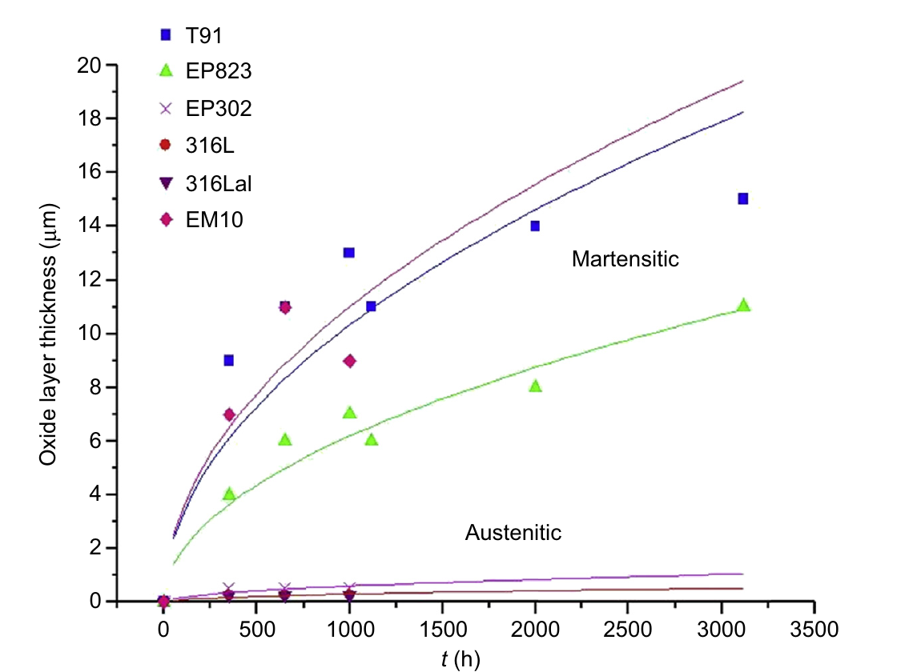
Temperature Limits for Bare Steels
Steel class | Dissolution regime (low O) | Oxidation regime (O controlled)
Austenitic (316L) | 350–400°C | 400–450°C
Ferritic/martensitic (T91) | 400–450°C | 450–500°C
Austenitic steels oxidize slowly but are vulnerable to Ni dissolution
F/M steels resist dissolution but grow overly thick oxides and suffer LME
Thick scales spall, cut heat transfer, and lose protectiveness
Above ~500°C, Al-alloying, Al₂O₃ coatings, or new alloys are needed
This practically limits the temperatures at which LFRs can operate
Oxide thickness, flowing LBE, 470°C, 1.9 m/s, [O] = 10⁻⁶ wt%. Fazio & Balbaud, Structural Materials for Gen IV Reactors (2017)

Slide 4
Surface Protection Above ~500°C
Al surface alloying
Electron beam melts an Al or FeCrAlY layer into the surface
  FeCrAlY-alloyed 15-15Ti withstood flowing LBE (10⁻⁶ wt% O) for 5000 h at 500–600°C
Hot-dip aluminizing (700C bath + anneal) and pack cementation (~750C; 40–120 μm layer)
Excess Al forms brittle Fe₂Al₅; homogeneity is difficult on large, complex parts
316L needs ~5.2–6.2 wt% Al to form Al₂O₃
Al₂O₃ coatings
PLD: amorphous Al₂O₃ with nanocrystallites resisted Pb at 550C for 4000 h, even at low O
  Low deposition T keeps AIM-1 cold work; deforms a few %; tolerates heavy-ion damage
ALD and detonation gun are promising, but HLM data are scarce
Coatings keep the substrate unchanged (easier qualification) but cannot self-heal
Must prove adhesion on large parts, stability under irradiation and strain
Bassini et al., Comprehensive Nuclear Materials 2nd ed. (2020)

Slide 5
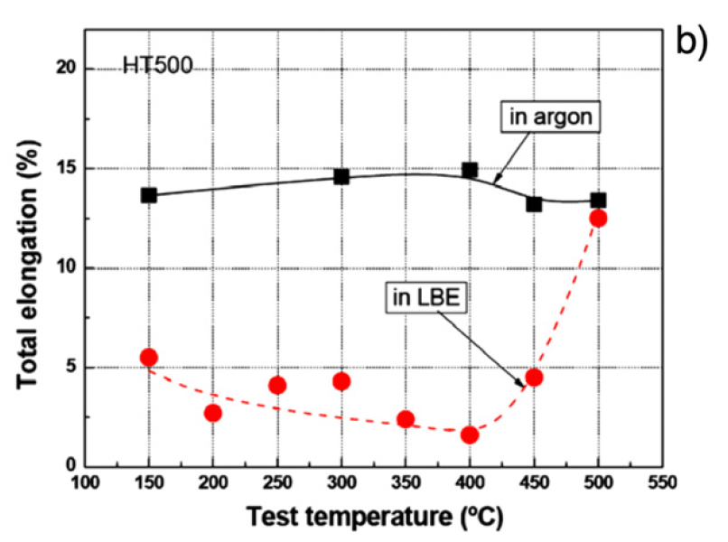
Mechanical Property Effects
Liquid metal embrittlement (LME) is a known phenomenon, but its mechanism is not fully understood
Contact with LM causes a decrease in ductility, resulting in a premature brittle failure in an otherwise ductile material
LME occurs by nucleation of a crack at the wetted surface of a solid and the subsequent propagation into the bulk until ultimate failure

Slide 6
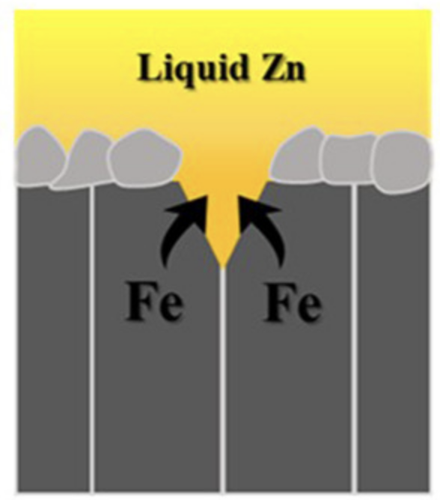
Liquid metal embrittlement (LME)
The loss of ductility of solid metals when in contact with liquid metal appears to be limited to a particular temperature range known as the ductility trough
For F/M T91 steel, the ductility trough is 350–425C in liquid Pb and 160–425C in LBE
The ductility trough is detected by following the evolution of the ultimate tensile stress or energy to rupture with temperature
The working theory on LME is based on a reduction of the surface energy by absorption of liquid metal atoms at the crack tip of the solid

Slide 7
Summary
Pb/LBE offer high boiling points and low chemical reactivity; corrosion is the central materials challenge
High Ni solubility makes austenitic steels vulnerable
Thermal mass transport occurs in flowing loops; flow also adds flow accelerated corrosion and potentially oxide erosion
Corrosion proceeds by dissolution (low O) or oxidation (controlled O); excess O can lead to oxide precipitates
O control (~10⁻⁶–10⁻⁷ wt%) protects bare steels up to ~450C; above ~500C, Al-alloying, Al₂O₃ coatings, or new alloys (e.g., FeCrAl) are needed
LME affects F/M steels (T91) in a ductility trough; austenitic steels are largely immune

Slide 8
End of Module 3
This concludes our module 3
Exam will take place Thursday (11/5)
Will cover molten salts, carbides and nitrides, and Pb-cooled reactors

Slide 9
advanced cladding

Slide 10
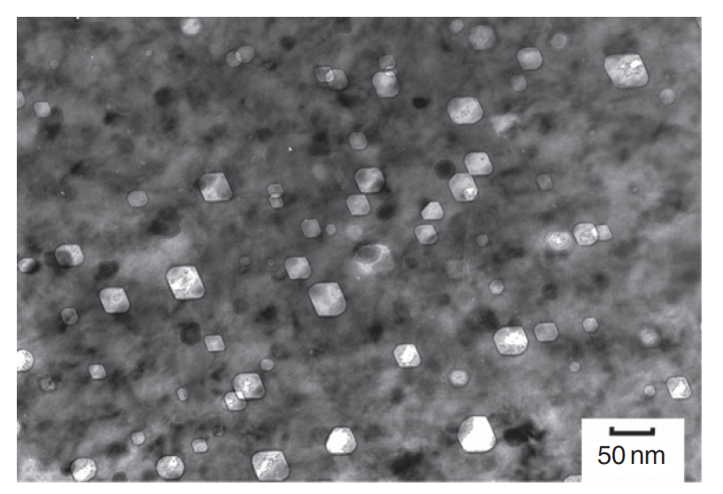
The need for advanced cladding
Austenitic stainless steels are widely used as structural components in nuclear service
At high dose, the microstructure develops a high concentration of voids, leading to dramatic swelling
Swelling of cladding in FFTF and BN-600
Void swelling in 304SS

Slide 11
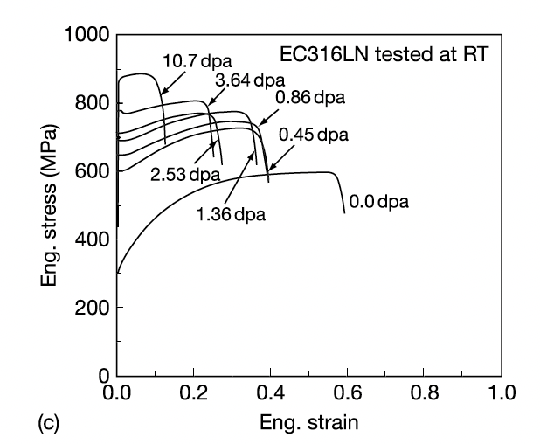
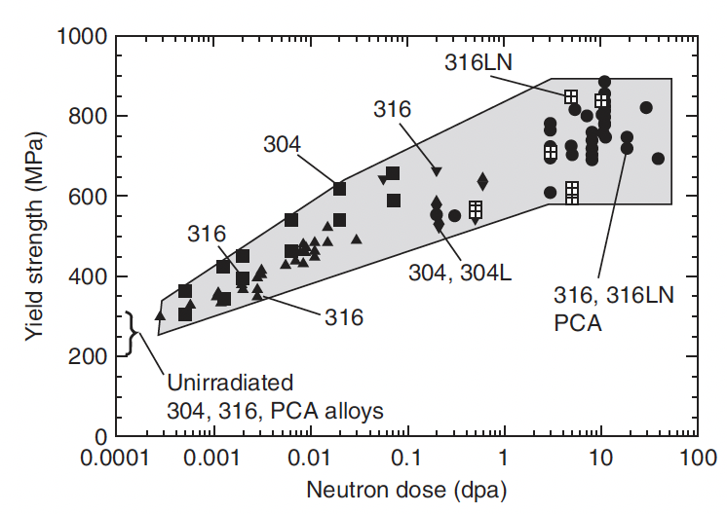
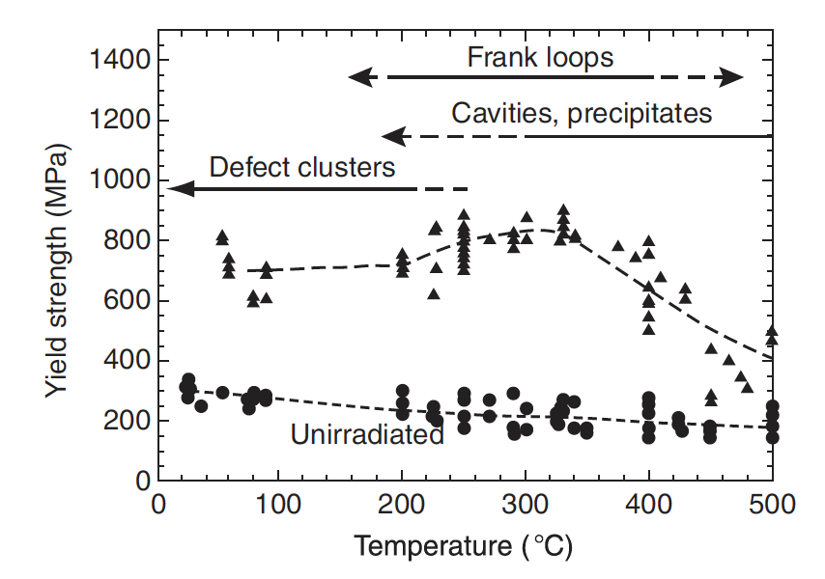
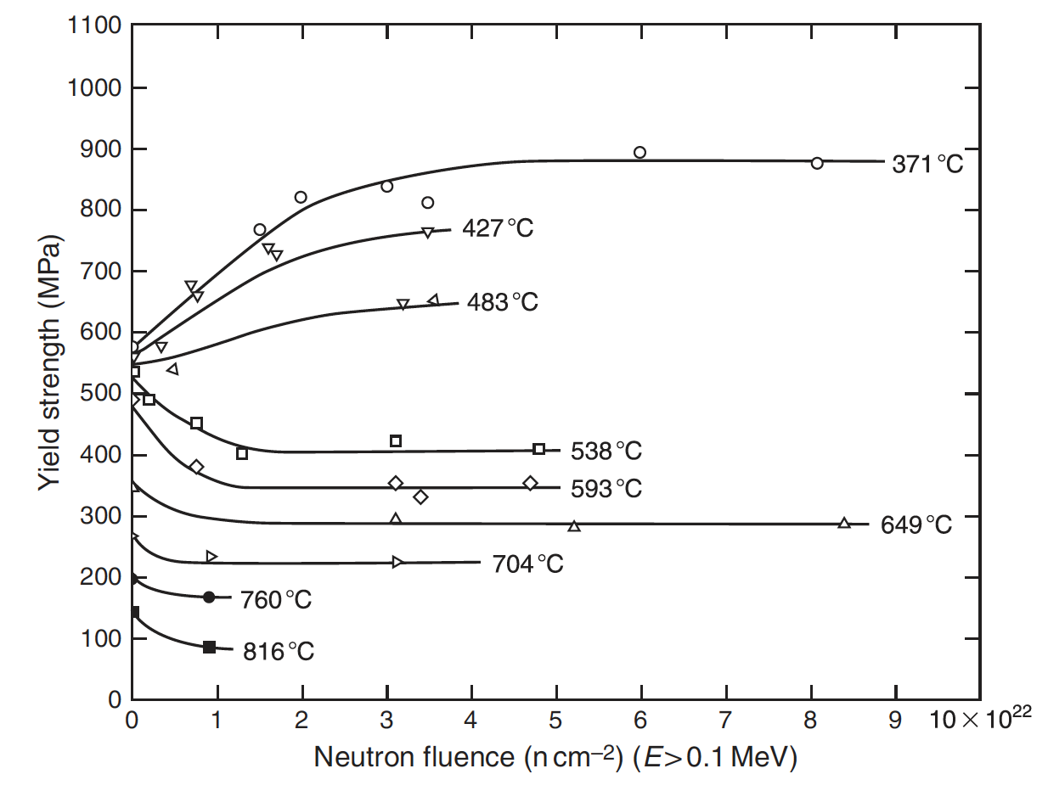
The need for advanced cladding
High fluence can also provide significant radiation hardening, coupled with severe losses in ductility
In addition to high fluence, high temperature contributes to void swelling
SS significantly weakens with increasing temperature
Thus, their applicability is limited in advanced reactor systems where high dose and high temperature are present

Slide 12
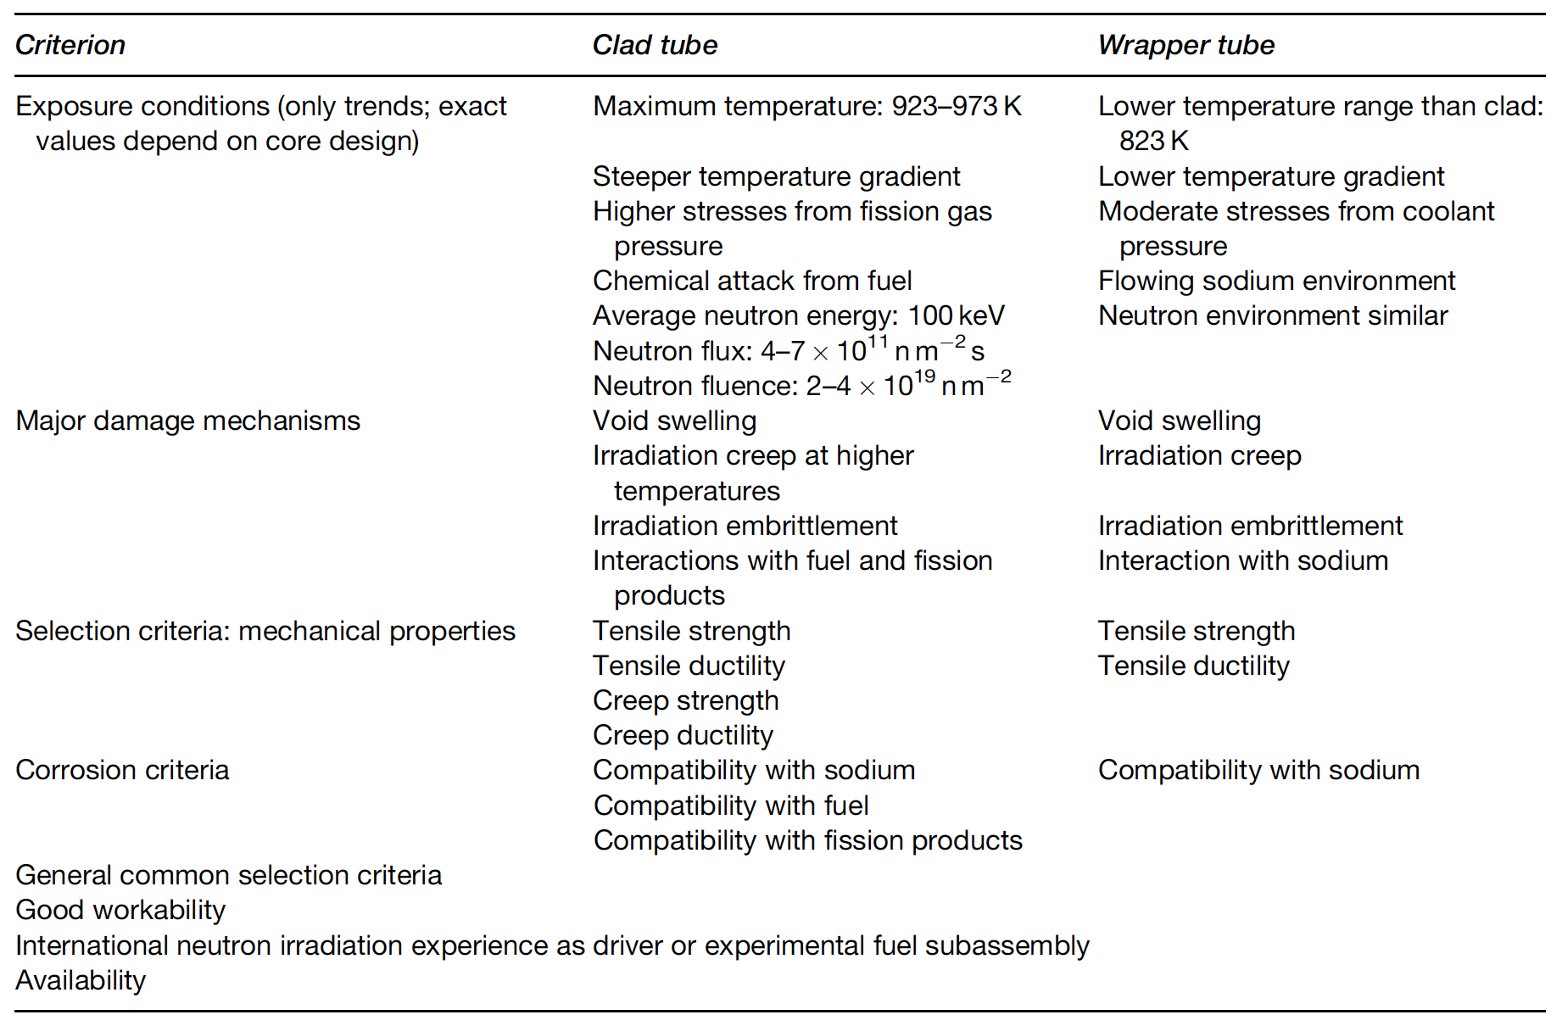
Fast Reactor Conditions
The structural components experience a different environment in advanced fast reactors than those in commercial LWRs
Key phenomena include void swelling, irradiation growth, irradiation hardening, irradiation creep, and helium embrittlement

Slide 13
Ferritic and Ferritic-Martensitic Steels

Slide 14
Ferritic and Ferritic-Martensitic Steels
The advanced ferritic and ferritic–martensitic steels of current interest have evolved from creep-resistant ferritic steels
Subsequent developments through different levels of Cr and Mo have led to the current ferritic and ferritic–martensitic steels: 9–12% Cr–Mo steels
F-M steels have advantageous mechanical properties, are relatively cheap, and control of their microstructure can be performed with heat treatments
F-M steels generally have worse high T mechanical properties than austenitic steels, especially creep life and irradiation creep resistance

Slide 15
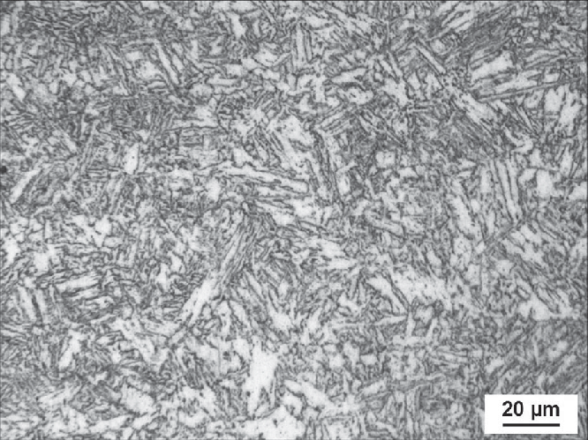
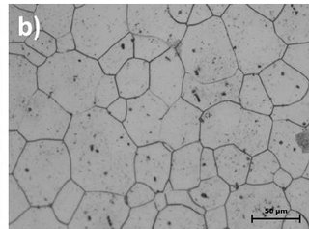
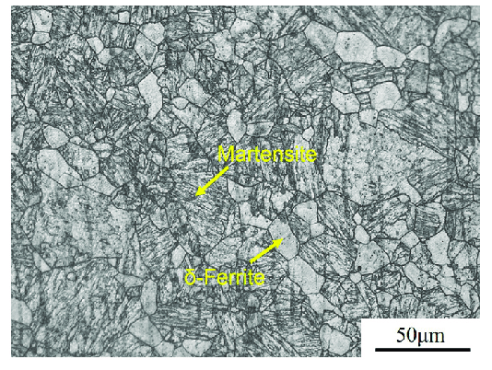
Crystal and Microstructures
alpha-Fe: ferrite, bcc
gamma-Fe: austenite, fcc
delta-Fe: high temperature ferrite, bcc
martensite: C-rich bct
pearlite: lamellar combination of ferrite and cementite (Fe3C)
also upper and lower bainite: don’t worry about it
alpha’: Cr rich ferrite (mainly induced via thermal aging)
martensite
ferrite
ferrite-martensite

Slide 16
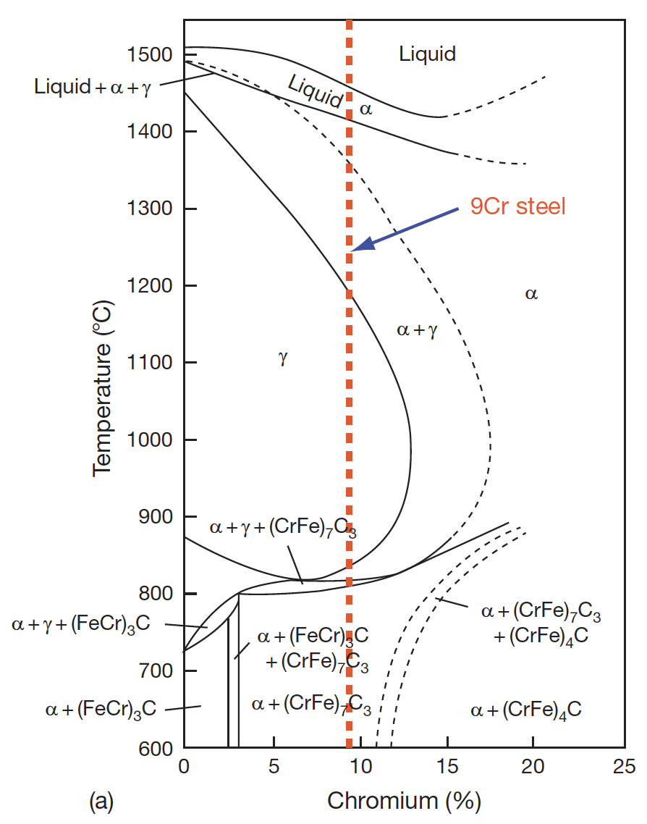
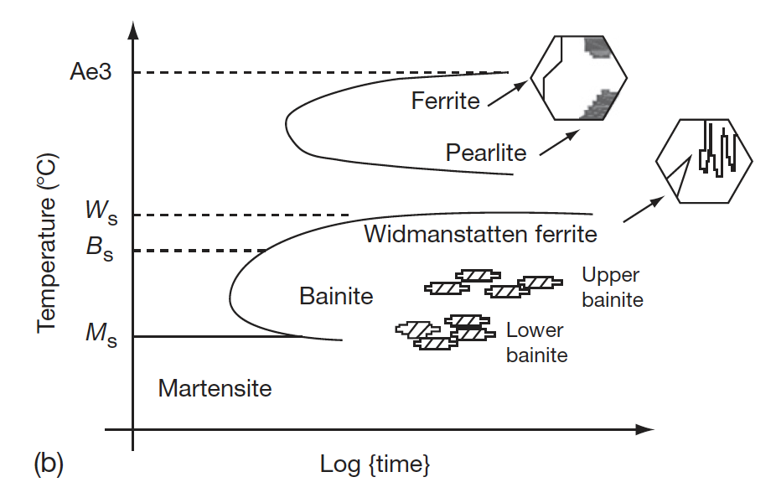
Ferritic-Martensitic Steels
The ability to retain ferrite is dependent upon the alloying elements and the heat treatments
In addition to Cr and Mo, the amount of Si, V, and C affect the phase boundaries
Accordingly, the 9-12% Cr/Mo family of steels can either be martensitic (9Cr–1MoVNb (T91)), ferritic (12Cr–1MoVW (HT9)) or ferritic–martensitic (9Cr–2Mo–V–Nb (EM12)) steel
TTT diagram of austenite
Pseudo-binary phase diagram with Cr equivalent

Slide 17
Composition Effects
The development of 9Cr-Mo steels was initially focused on oxidation resistance and creep strength
The optimized initial alloy composition considered was 9Cr, 2Mo, 1W, 0.5Si, with C, B, V, Nb, and Ta in small amounts
A reduction in Cr content lowers the oxidation resistance
Higher Cr content has two effects, 1) it increases the hardenability leading to the formation of martensite, and 2) promotes the formation of δ-ferrite, reducing the toughness
If the W+Mo concentration is kept <3%, creep strength will reduce, while higher amount promotes the formation of δ-ferrite and brittle Fe2Mo Laves phase

Slide 18
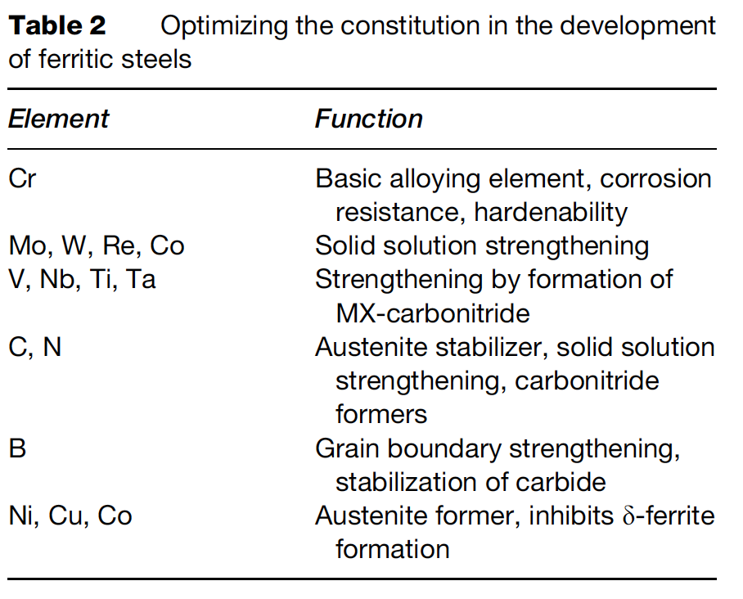
Composition Optimization
The addition or replacement of Mo with W and B increases the stability of M23C6
Lower Ni content introduces δ-ferrite, while its increase reduces creep strength
Lower Si reduces oxidation resistance, while higher Si content leads to agglomeration of carbides
The composition of all other elements can be optimized, based on structure–property correlation studies

Slide 19
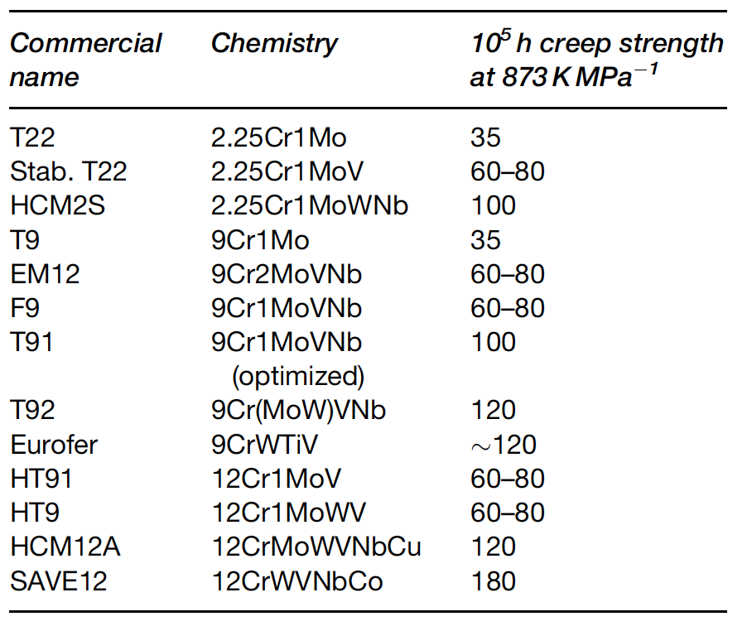
Composition Optimization
The development of high creep-rupture strength steels is based on optimizing the composition, δ-ferrite content, increasing the stability of the martensite, dislocation structure, and maximizing the solid solution and precipitation hardening
Based upon this property tailoring, a large number of alloys have been developed over the last 75 years
Reduced activation ferritic-martensitic (RAFM) steels steels have been developed in order to make concentrations of high activation residual elements lower

Slide 20
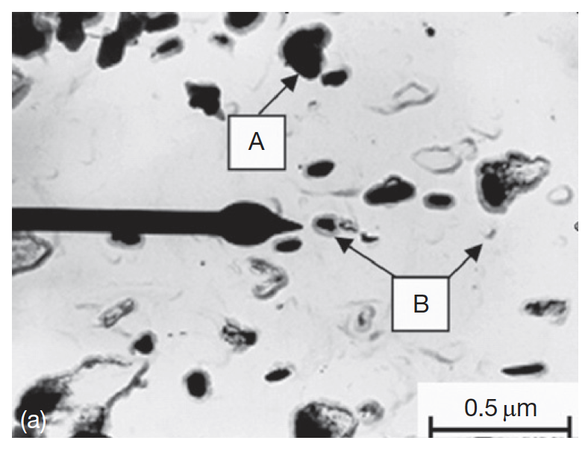
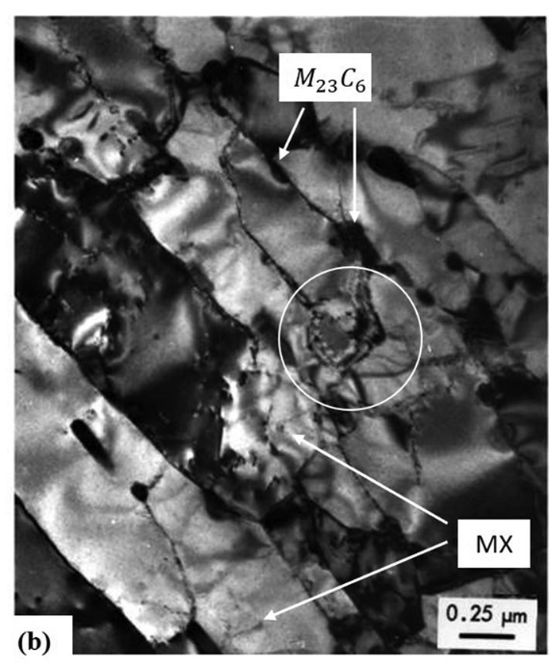
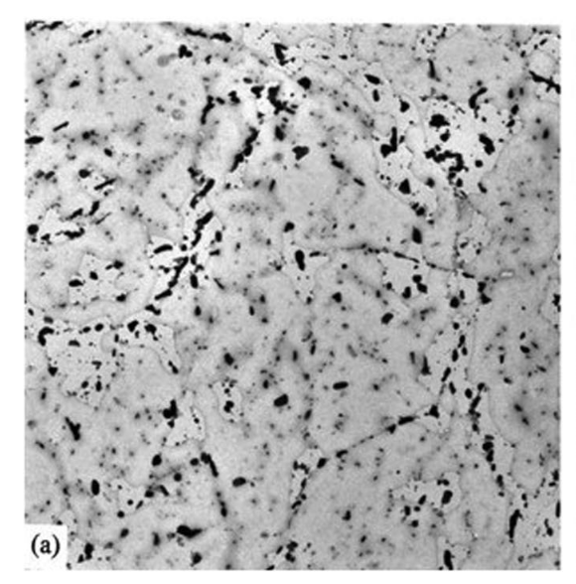
Microstructure
The microstructure of the steels consists of a) martensite laths containing dislocations; b) coarse M23C6 particles located at prior austenite and ferrite grain boundaries; c) finer carbide precipitates found within the laths and at the lath/subgrain boundaries
M2X precipitates rich in Cr also form
HT-9 initial microstructures

Slide 21
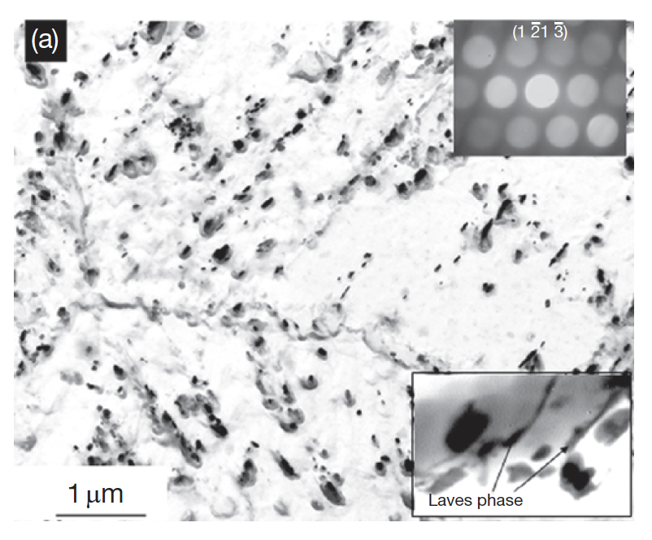
Microstructure
In reactor, this microstructure will change, with the M2X precipitates being replaced by MX intermetallic and Laves phases due to long exposure to high temperature
There are three types of processes with respect to evolution of secondary phases: irradiation-induced precipitation, irradiation-enhanced transformations, and the irradiation modified phases
The evolution of these phases depends on the composition and structure of the steel and the irradiation parameters like the temperature and fluence
Fe2Mo Laves intermetallic phase around the M23C6

Slide 22
Radiation Damage
Dislocation loops are the primary defect species observed
Loops are typically larger and with a lower number density as the irradiation temperature is increased
Loop size and density are increased as a function of dose, with loop density potentially saturating at 10 dpa
Voids can also form above 400C
Radiation-induced segregation can occur in these steels, but has been significantly less studied than in austenitic steels
General consensus that Cr is depleted at interfaces (at high T), and Ni, Si , and P are enriched at sinks
RIS appears to be dependent on both irradiation dose and temperature

Slide 23
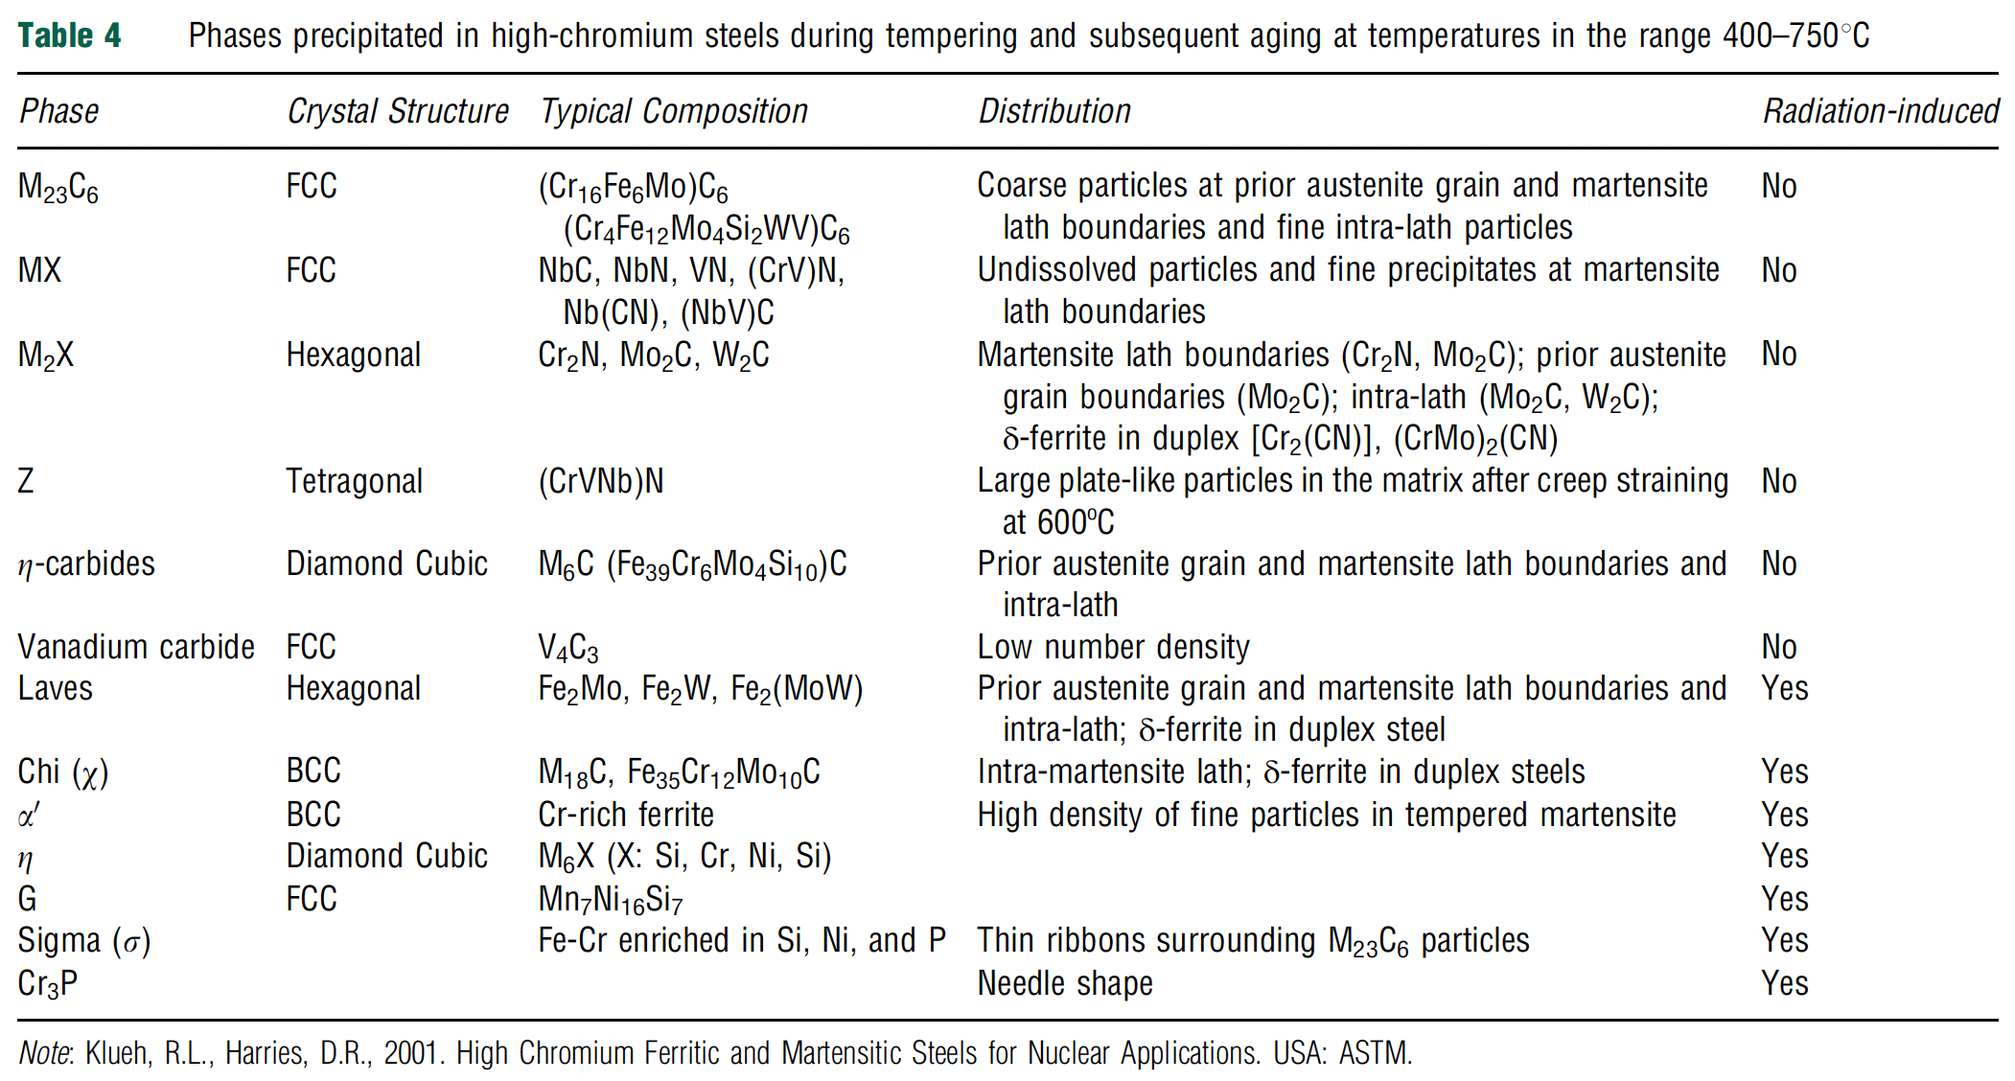
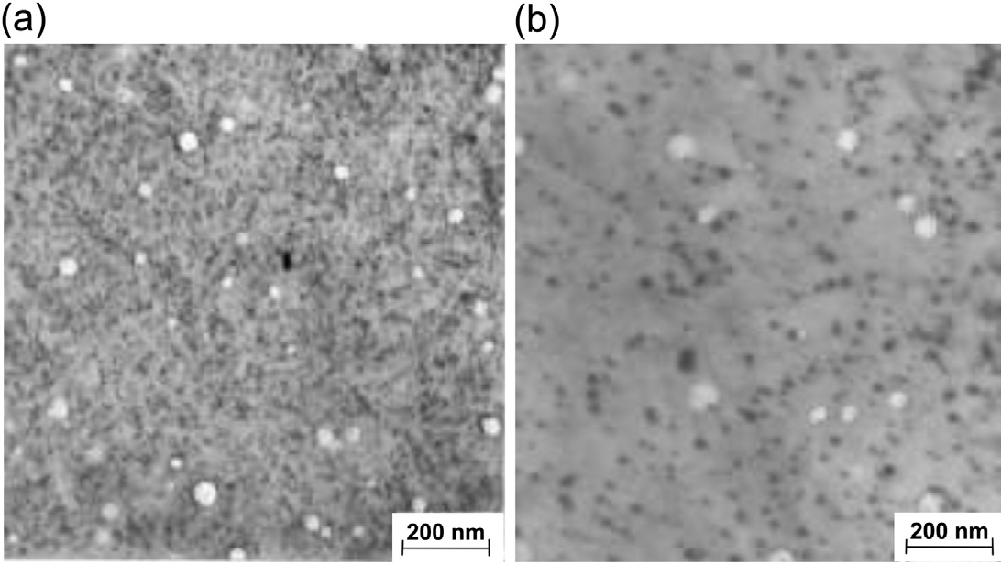
Phase Precipitation
Thermal processing will lead to precipitation, which affects the mechanical properties
Most of the carbon forms in M23C6 precipitates, which increase strength and reduce ductility
RIS leading to Cr depletion increases the matrix Cr composition and can lead to alpha’ formation, which embrittles the material
Chi, G, and sigma phases are enriched in Si and Ni and can nucleate at interfaces
alpha’
chi

Slide 24
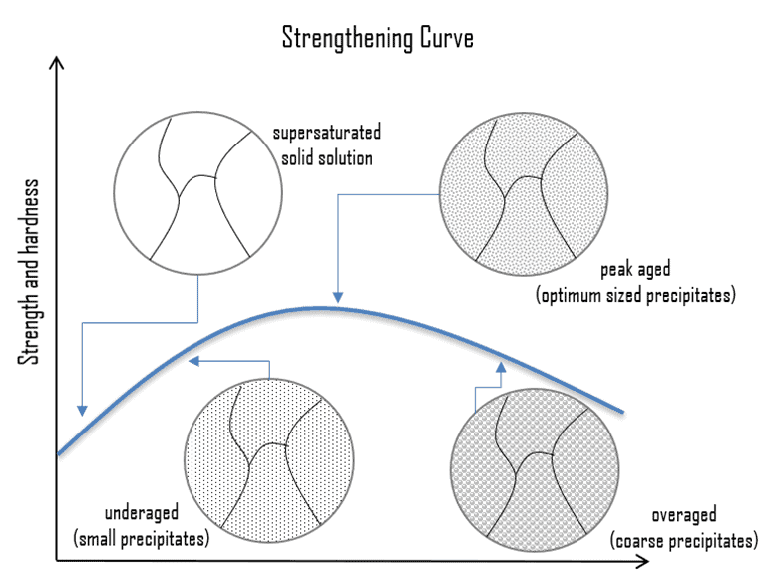
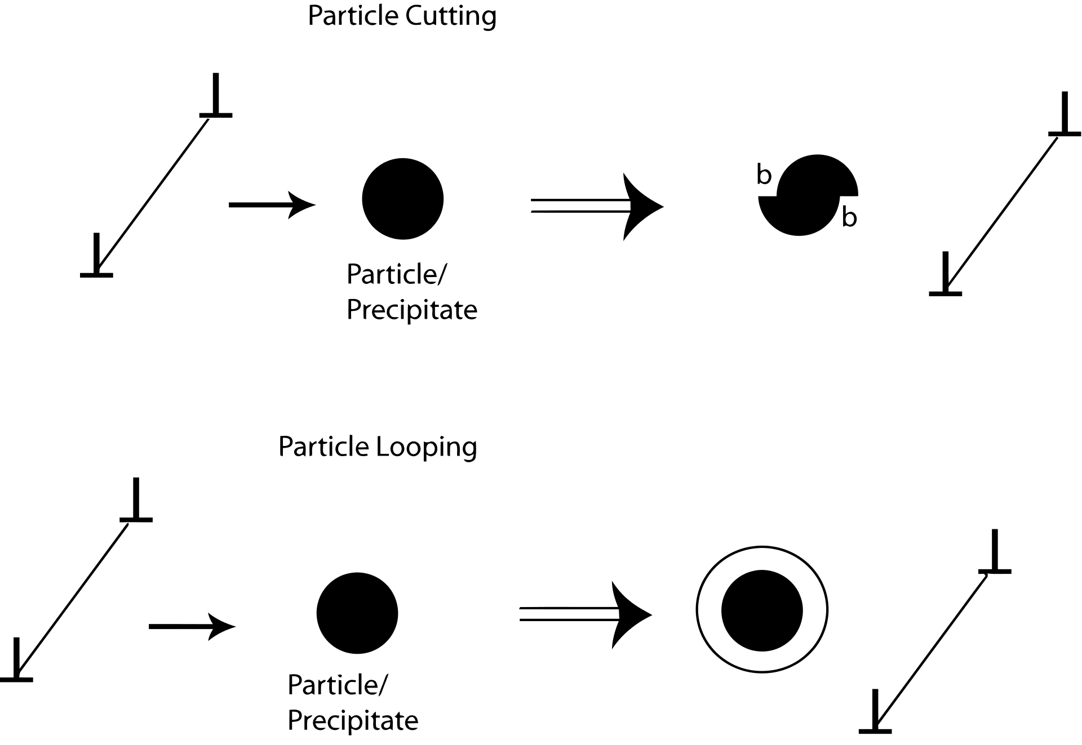
Precipitate Hardening
Precipitation hardening relies on changes in solid solubility with temperature to produce fine particles of an impurity phase which impedes the movement of dislocations
Since dislocations are often the dominant carriers of plasticity, this serves to harden the material

Slide 25
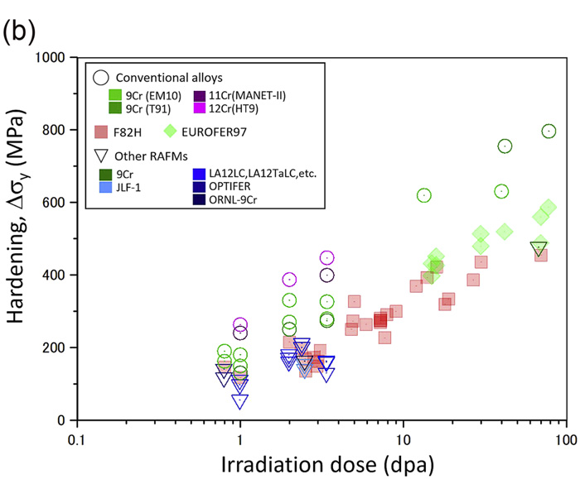
Irradiation Hardening
Microstructure changes lead to irradiation hardening of the steel
High amounts of carbon in 12% Cr steels leads to a large amount of precipitation, up to twice as much as 9% Cr steels
This high carbon content is needed to use steels as martensite
Both the steels have mainly M23C6 carbides with a small fraction of monocarbides
This high concentration of precipitates can eventually lead to brittle failure
The critical stress is inversely proportional to the crack length, crack length is equal to the diameter of the carbide precipitate, thus fracture stress also decreases with increasing precipitate size

Slide 26
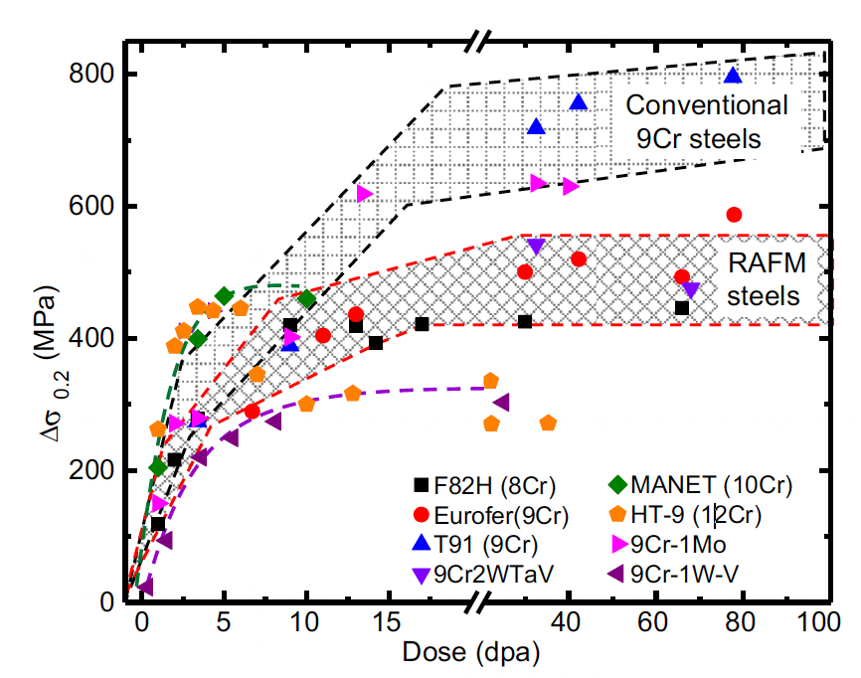
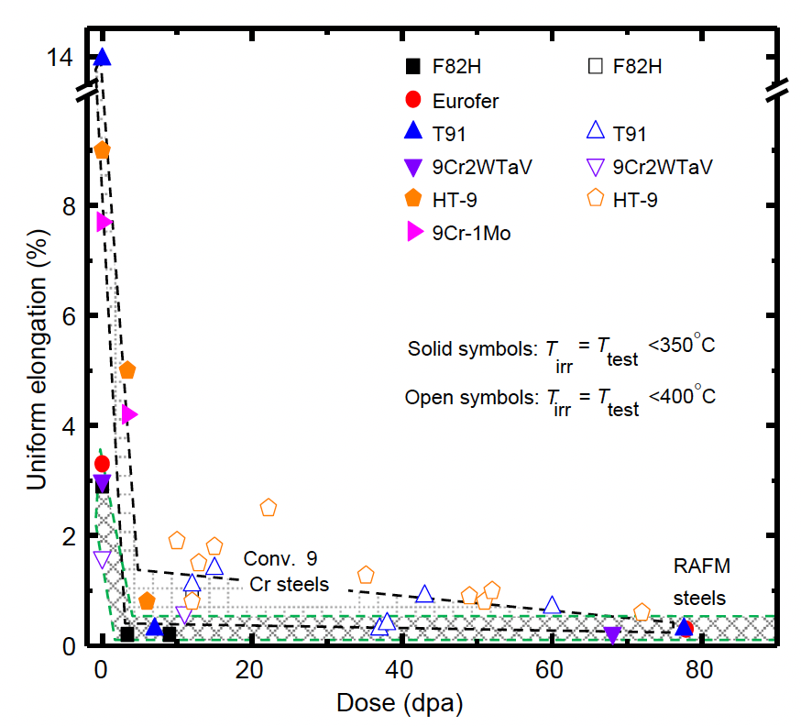
Irradiation Hardening
The increase in density of point defects clusters, dislocation loops, and second phases can result in a significant increase in yield stress in the first 5-10 dpa
For irradiations to higher doses, the increase in yield strength saturates because the defects begin to annihilate each other as steady-state defect concentrations are produced
In conjunction with the increase in yield strength, a significant reduction in uniform elongation is observed
A sharp drop to less than 2% elongation is observed after only a few dpa
These are for low T irradiations, less than 400C

Slide 27
Irradiation Creep Resistance
Irradiation creep resistance needs a good combination of thermal creep behavior and long-term microstructural stability at high temperature
In order to fabricate creep resistant steels, you design to have a number of microstructural features that are present
  Introduce high dislocation density to increase the strength of the basic lattice
  Strengthen the host lattice by solid solution strengtheners or defects
  Stabilize the boundaries created by phase transformations by precipitating carbides along the boundaries
  Arrest dislocation glide and climb by selection of crystal structure, solid solution, interfaces, dislocation interactions
  Resist sliding of grain boundaries by introducing special types of boundaries and anchoring the boundaries with precipitates

Slide 28
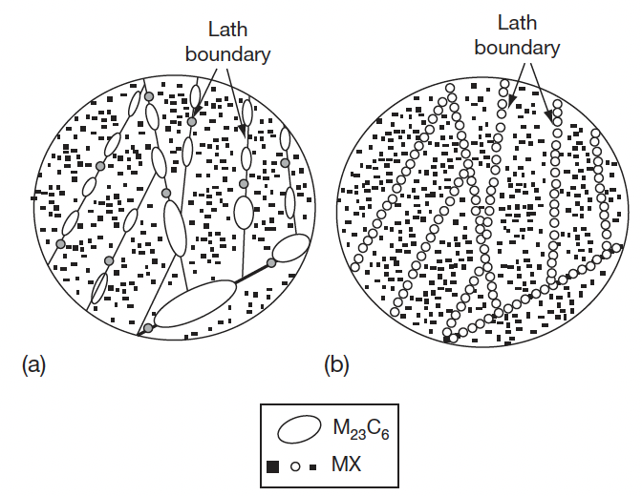
Irradiation Creep Resistance
Ensure long-term stability of the microstructure, especially against recovery and coarsening of the fine second phase particles
In the case of 9–12 Cr steels, the martensitic lath structure decorated with only MX which should be stable over long-term service life is the most desired structure
MX can be stabilized over M23C6 by reducing the carbon content, but we need high amounts of C to have appropriate high temperature behavior
undesirable
desirable

Slide 29
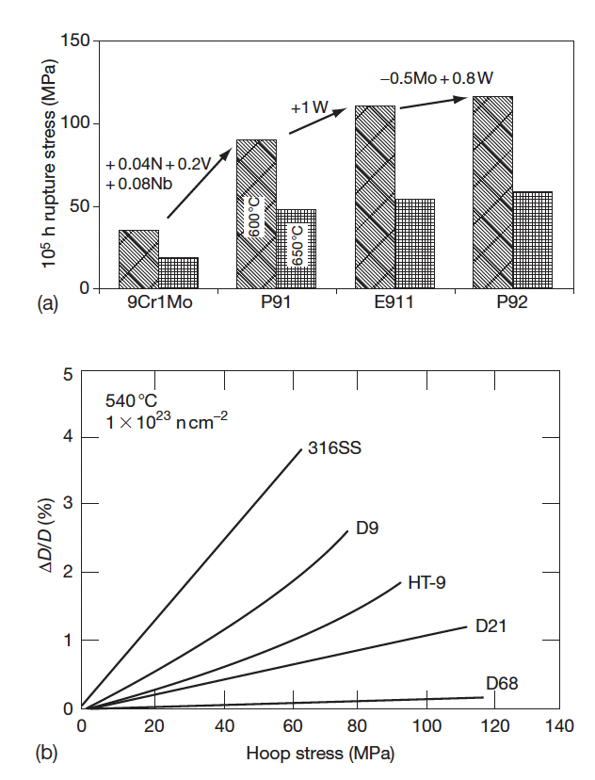
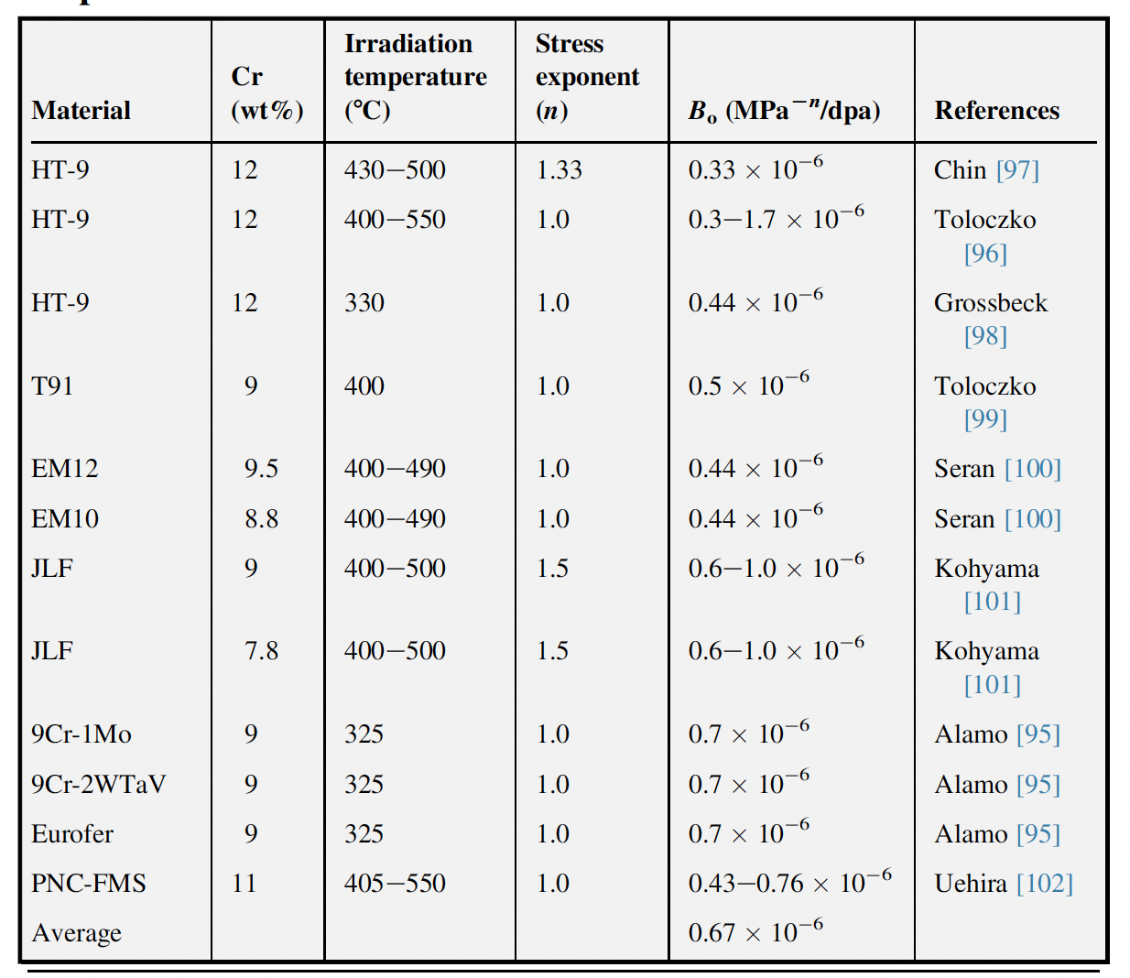

Irradiation Creep Resistance
Thermal Creep
So careful tailoring of alloying elements has led to improvement of the creep strength
Thermal creep behavior provides a starting point, which can then be refined by studying creep under irradiation
The irradiation creep depends on the stress level, the temperature, and the dose
Irradiation Creep

Slide 30
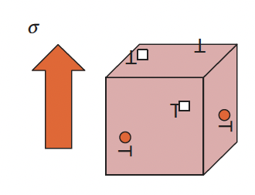
Irradiation Creep Resistance
The excess point defects precipitate into either interstitial or vacancy loops, but not randomly
The interaction between point defects and stress leads to the precipitation of interstitial loops parallel to the applied stress, while vacancy loops form in planes perpendicular to the stress: stress-induced preferential nucleation (SIPN)
Under applied stress, the vacancies migrate preferentially to grain boundaries perpendicular to the applied stress, while the interstitials move toward boundaries parallel to the stress: stress-induced preferential absorption (SIPA)
SIPN
SIPA

Slide 31
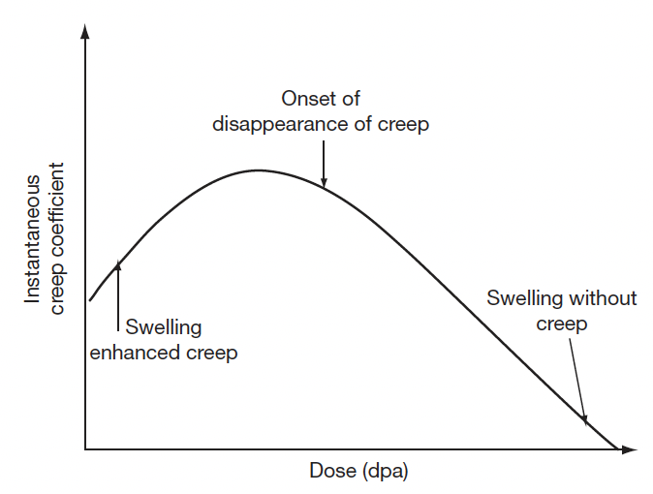
Creep Evolution
The radiation-induced defects also evolve from isolated point defect to loops and voids, which have different types of influence on irradiation creep
Irradiation creep occurs simultaneously with swelling and swelling can influence irradiation creep
At very small dose levels, swelling enhances creep rates; beyond a certain dose level the creep component reduces; at high dose levels creep disappears, while swelling continues

Slide 32
Irradiation Embrittlement
Ferritic steels have a large number of monocarbides which aid in creep resistance
The lath boundaries are decorated with Cr rich M23C6 precipitates which increase the thermal stability
Embrittlement is caused by 1) segregation of elements to lath boundaries which make the grain boundaries decohesive, and 2) evolution of carbides and intermetallic phases
For removable components such as cladding, which are subjected to high temperature and pressure with a residence time of a few years, creep is the issue which decides their design and performance
For permanent support structures increase in hardening and loss in fracture toughness on irradiation are major issues

Slide 33
Irradiation Embrittlement
The increase in the ductile to brittle transition temperature, DBTT, is known to be related to irradiation hardening, which is generally observed to saturate with fluence
Evidence for a possible maximum in DBTT was observed for the 12Cr steel irradiated in the range of 35–100 dpa in the FFTF
High fluence and/or high temperature are required before a maximum is observed
Thus, these properties are a balance between the point defect production and irradiation-induced precipitation
The precipitation during irradiation hardens the steel and irradiation accelerated recovery and aging soften the steel
The high temperature recovery produces an observable saturation in hardening above ~720K

Slide 34
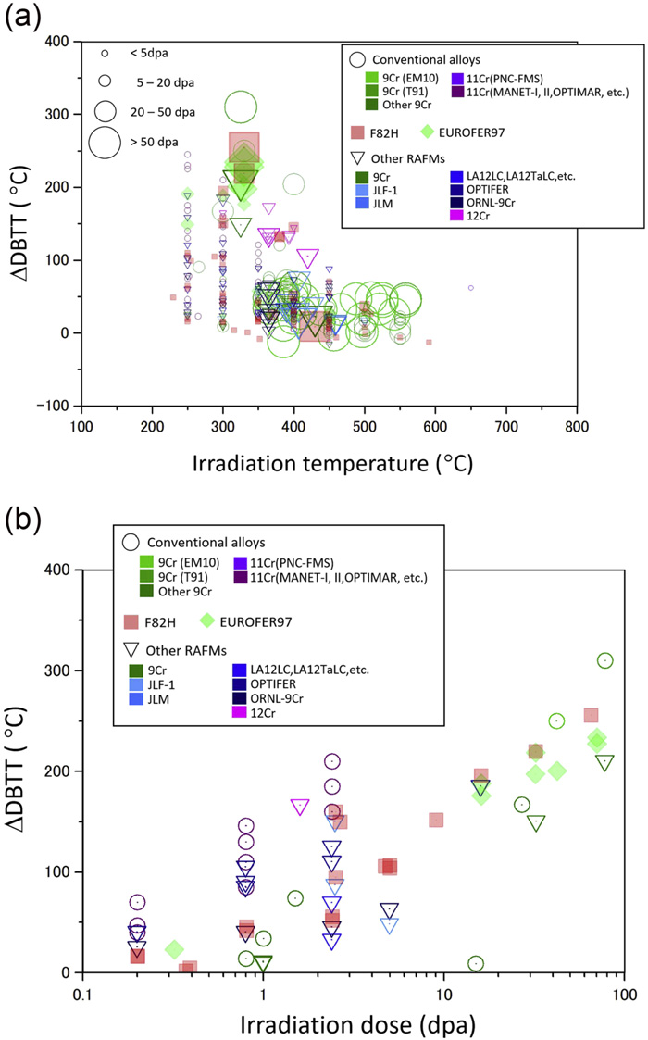
DBTT Changes

Slide 35
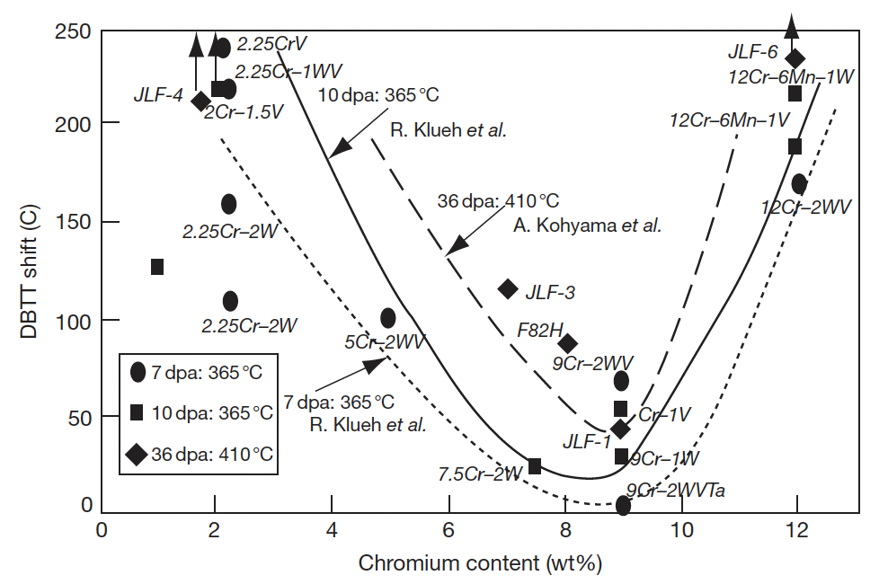
DBTT
BCC materials can undergo significant increase in the DBTT at low T for even 1 dpa
The minimum operating temperature to avoid embrittlement F/M steels is ~600 K
Extensive evaluation of the embrittlement behavior of the ferritic steels for different compositions has been performed
Compositions around 9Cr show the least change in the DBTT, and addition of phosphorous, copper, vanadium, aluminum, and silicon increase the DBTT
The 12Cr steels, like HT9, show a larger shift in DBTT as compared to modified 9Cr–1Mo steel, balancing between swelling resistant 12Cr steels and 9Cr steel which is less prone to embrittlement than 12Cr steels

Slide 36
Features affecting Embrittlement
There are a number of microstructural features that can impact the embrittlement of F/M steels
Prior austenite grain size (PAGS)
The size of martensitic lath (which is sensitive to austenitization temperature)
Tempering/annealing, which can increase carbide precipitate size
The generation of helium through (n,alpha) reaction
  in high Ni alloys, He generation can also impact swelling

Slide 37
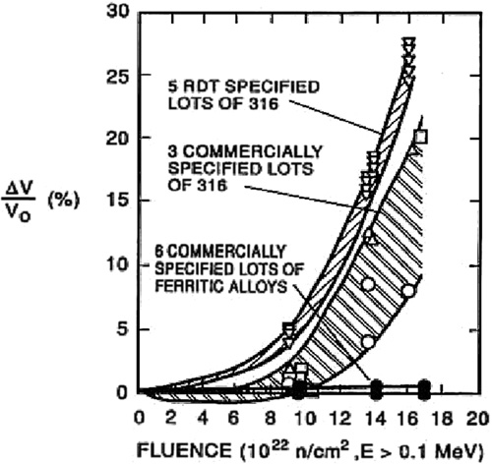
Void Swelling Resistance
Ferritic steels were experimentally observed to exhibit superior radiation resistance compared to austenitic steels, which is largely based on their low swelling behavior
The 9Cr–1Mo steel, modified 9Cr–1Mo (Grade 91), 9Cr–2Mo, and 12Cr–1MoVW (HT9) have low swelling rates at doses as high as 200 dpa
The threshold dose for swelling in ferritic steels is as high as nearly 200 dpa, compared to 80 dpa for the present generation austenitic stainless steel
HT9 shows 1% swelling at 693 K for 200 dpa

